Slide 1
Normalization

Slide 2
Normalisation and Business Rules
The following is a simple example of normalisation of some typical sales data
There are 3 cases.
▪
▪
-
Each is based on different assumptions about the nature of the
business (business rules).
▪
In each case, the primary key (PK) requires a different combination
fields to uniquely identify records in the table
of
▪
Differences in the PK lead to differences in the
proceeds
way normalisation

Slide 3
A
traditional
data
file
–
sales
data
Date
Product
Price
Client
Phone
Address
11 Jan
Widget
100
Nurk Inc.
666-999
11 Bush Ave
12 Jan
Gizmo
120
Klutz & Co
131-313
13 Luck Rd
12 Jan
Widget
100
Bloggs Ltd
123-456
12 High St
13 Jan
Widget
100
Klutz Coy.
131-323
13 Luck Rd
14 Jan
Gizmo
120
F. Nurk Inc.
666-999
11 Bushy Ave
Contains unnormalised data

Slide 4
CASE 1
▪
Here
-
-
-
we assume that
Each client makes no more than one order per day
No two clients have the same name
Each order consists of a single product
▪
In this case we can use DATE
and
CLIENT
to
provide
a
composite
primary
key

Slide 5
Identify
primary
key
Date
Product
Price
Client
Phone
Address
11 Jan
Widget
100
Nurk Inc.
666-999
11 Bush Ave
12 Jan
Gizmo
120
Klutz & Co
131-313
13 Luck Rd
12 Jan
Widget
100
Bloggs Ltd
123-456
12 High St
13 Jan
Widget
100
Klutz Coy.
131-323
13 Luck Rd
14 Jan
Gizmo
120
F. Nurk Inc.
666-999
11 Bushy Ave

Slide 6
UNF
Date
Product
Price
Client
Phone
Address
All fields depend on PK
UNF→1NF: Identify a primary key
No repeating groups
UNF→1NF: Repeating groups
NONE
1NF
Date
Product
Price
Client
Phone
Address

Slide 7
1NF
Date
Product
Price
Client
Phone
Address
1NF→2NF: Remove partial dependencies on PK
2NF
Client
Phone
Address
Date
Client
Product
Price

Slide 8
2NF
Client
Phone
Address
Date
Client
Product
Price
2NF→3NF: Remove transitive dependencies
3NF
Client
Phone
Address
Product
Price
Date
Client
Product

Slide 9
CASE
1:
Summary
UNF
Sale (date, product, price, client, phone, address)
1NF
Sale (date, product, price, client, phone, address)
2NF
Customer (client, phone, address)
Sale (date, product, price, client)
3NF
Item (product, price)
Customer (client, phone, address)
Sale (date, product, client)

Slide 10
CASE 2
Suppose that in any single day
▪
-
-
Clients sometimes make several orders
Each order is for a different product
▪
Then the combination of DATE and CLIENT no longer provides a
unique identifier for each record
We need to include PRODUCT to uniquely identify each record
Our primary key is thus a composite key consisting of DATE, CLIENT
and PRODUCT
This case leads to a slightly different normalization process, but a similar end result
▪
▪
▪

Slide 11
CASE
2:
Summary
UNF
Sale (date, product, price, client, phone, address)
1NF
Sale (date, product, price, client, phone, address)
_{2NF}
Item (product, price)
Dependency is
now
partial, not
transitive
Customer (client, phone, address)
Sale (date, product, client)
3NF
Item (product, price)
Customer (client, phone, address) _{2NF}
Sale (date, product, client)
Same as

Slide 12
CASE 3
Suppose that clients sometimes order the same product several times in a single day
So the combination of DATE, CLIENT and PRODUCT no longer provide a candidate key
We have no choice but to add a new field (call it "SALE") that uniquely identifies each record and can therefore serve as a primary key
•
•
•
•
Once again,
this case leads
to
a
slightly
different
normalization
process,
but
a
similar
end
result

Slide 13
Identify
a
primary
key
Sale
Date
Product
Price
Client
Phone
Address
001
11 Jan
Widget
100
Nurk Inc.
666-999
11 Bush Ave
002
12 Jan
Gizmo
120
Klutz & Co
131-313
13 Luck Rd
003
12 Jan
Widget
100
Bloggs Ltd
123-456
12 High St
004
13 Jan
Widget
100
Klutz Coy.
131-323
13 Luck Rd
005
14 Jan
Gizmo
120
F. Nurk Inc.
666-999
11 Bushy Ave
Primary key

Slide 14
UNF
Date
Product
Price
Client
Phone
Address
UNF→1NF: Identify a primary key
ADD
Sale
Date
Product
Price
Client
Phone
Address
UNF→1NF : Remove nulls
NONE
UNF→1NF : Remove repeating groups
NONE
1NF
Sale
Date
Product
Price
Client
Phone
Address

Slide 15
UNF
Date
Product
Price
Client
Phone
Address
1NF
Sale
Date
Product
Price
Client
Phone
Address
1NF→2NF: Identify partial dependencies on PK
NONE
2NF
Sale
Date
Product
Price
Client
Phone
Address

Slide 16
Identify
transitive
dependencies
Sale
Date
Product
Price
Client
Phone
Address
001
11 Jan
Widget
100
Nurk Inc.
666-999
11 Bush Ave
002
12 Jan
Gizmo
120
Klutz & Co
131-313
13 Luck Rd
003
12 Jan
Widget
100
Bloggs Ltd
123-456
12 High St
004
13 Jan
Widget
100
Klutz Coy.
131-323
13 Luck Rd
005
14 Jan
Gizmo
120
F. Nurk Inc.
666-999
11 Bushy Ave
Primary key
Transitive dependencies

Slide 17
1NF / 2NF
Sale
Date
Product
Price
Client
Phone
Address
2NF→3NF: Identify transitive dependencies
3NF
Product
Price
Client
Phone
Address
Sale
Date
Product
Client

Slide 18
CASE
3:
Summary
UNF
Sale (date, product, price, client, phone, address)
1NF
Sale (sale, date, product, price, client, phone, address)
2NF
Sale (sale, date, product, price, client, phone, address)
3NF
Item (product, price) ^{2NF is the same as}
Customer (client, phone, address)
Sale (sale, date, product, client)
1NF

Slide 19
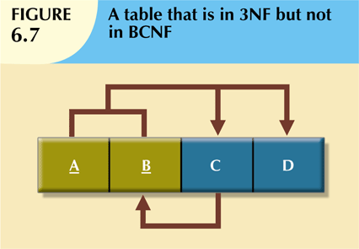
BCNF
• When table contains only one candidate key, the 3NF and the BCNF
are equivalent
•
BCNF can be violated only when table contains more than one
candidate key
Table can be in 3NF and fail to meet BCNF
•
-
No partial dependencies, dependencies
nor does it contain transitive
-
A
non-key
attribute
is
the
determinant
of
a
key
attribute

Slide 20
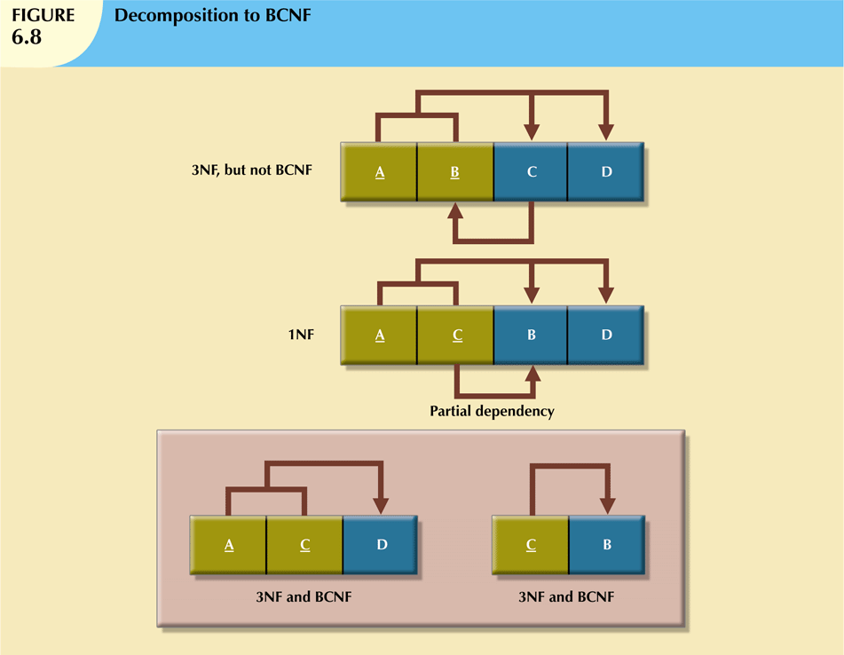
Decomposed
by
reassigning
PK

Slide 21
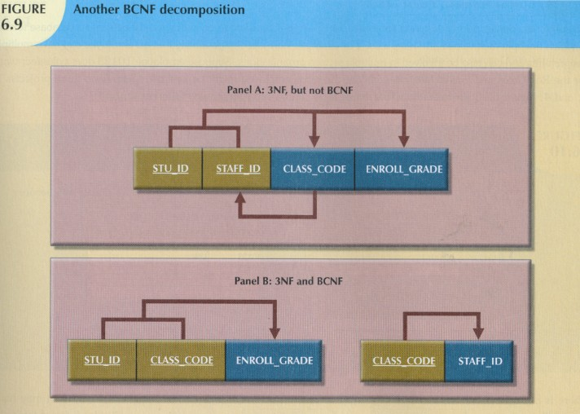
An
example
of
BCNF
decomposition

